Slide 1
HOME-CAVE
Online-handicraft-store

Slide 2
TEAM
NANDINI 2210030048
NAGA RANI 2210030030
AMRUTHA 2210030036
MANOGNA 2210030016

Slide 3
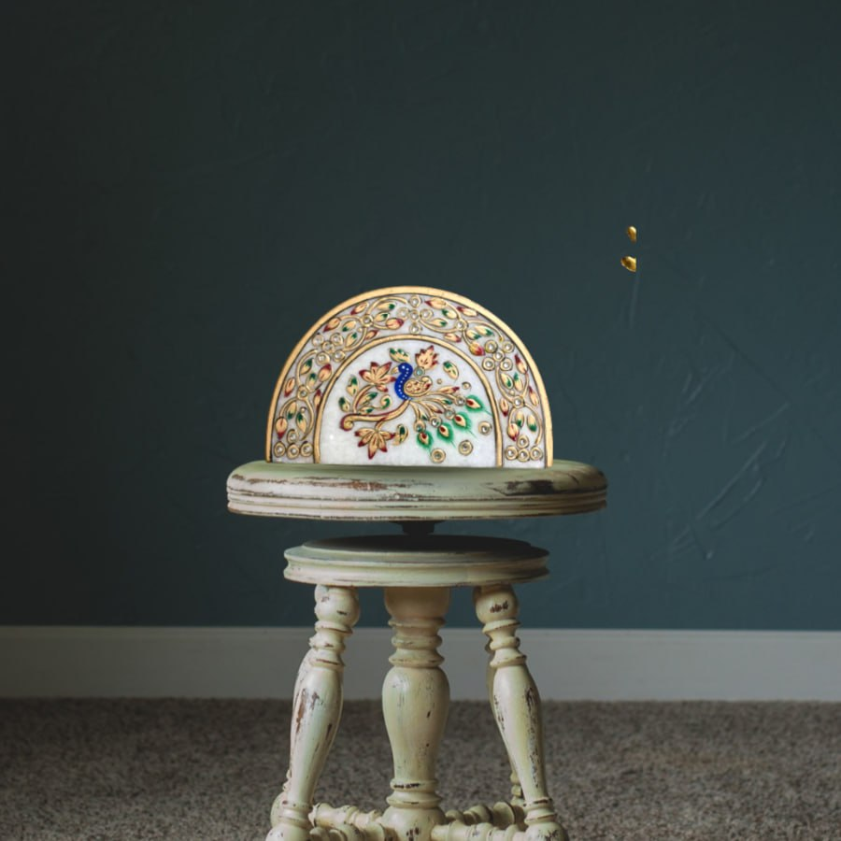
Introduction
The "ONLINE HANDICRAFTS STORE" project aims to create a web application for individual artisans to sell their unique handicrafts online, homely food, etc. The platform provides a quality service for shoppers and sellers, allowing users to register, sell, and place orders.

Slide 4
primary goals
The aim is to incorporate modern technology to provide artisans with a platform to
showcase their skills of crafts and cater to a wider range of audiences. This approach
reduces the cost of acquiring a middleman and provides an opportunity for a greater
profit margin for the sellers.

Slide 5
PROBLEM IDENTIFIED
There not many places that sells handmade goods, has a communication platform between users and sellers to create a trustworthy relation between each other.

Slide 6
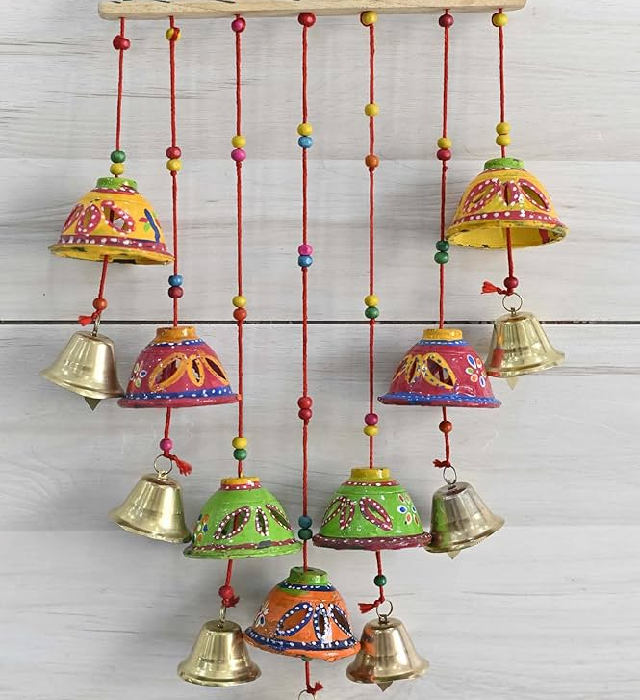
Artisan-Centric Approach
At Home-Cave, we prioritize the well-being of our artisans, ensuring fair compensation and safe working conditions. We believe in fostering a community where creativity thrives and traditional art forms are celebrated.

Slide 7
Product Categories
Handmade Jewelry
Explore our exquisite collection of handcrafted jewelry, including intricately designed earrings, necklaces, and bracelets. Each piece tells a story of skilled artisanship and timeless elegance, making it a perfect choice for those who appreciate unique accessories.
Home Decor
Immerse yourself in the world of artisanal home decor, featuring a diverse range of items such as handwoven textiles, decorative pottery, and intricately carved wooden artifacts. Our home decor products are a blend of tradition and modern aesthetics, adding character to any living space.
Art & Crafts
Discover the beauty of traditional art forms through our curated selection of art and crafts. From vibrant paintings to meticulously crafted sculptures, our collection showcases the talent and creativity of artisans, offering customers a glimpse into diverse cultural expressions.

Slide 8
TECHNOLOGY USED
Mongo db
Secure and scalable NoSQL database for efficient data storage and retrieval.
EXPRESS
Fast and minimalist web application framework for robust and rapid backend development.
REACT
Powerful JavaScript library for building UI components and creating interactive user interfaces.
NODE JS
Efficient and lightweight runtime environment for executing server-side JavaScript applications

Slide 9
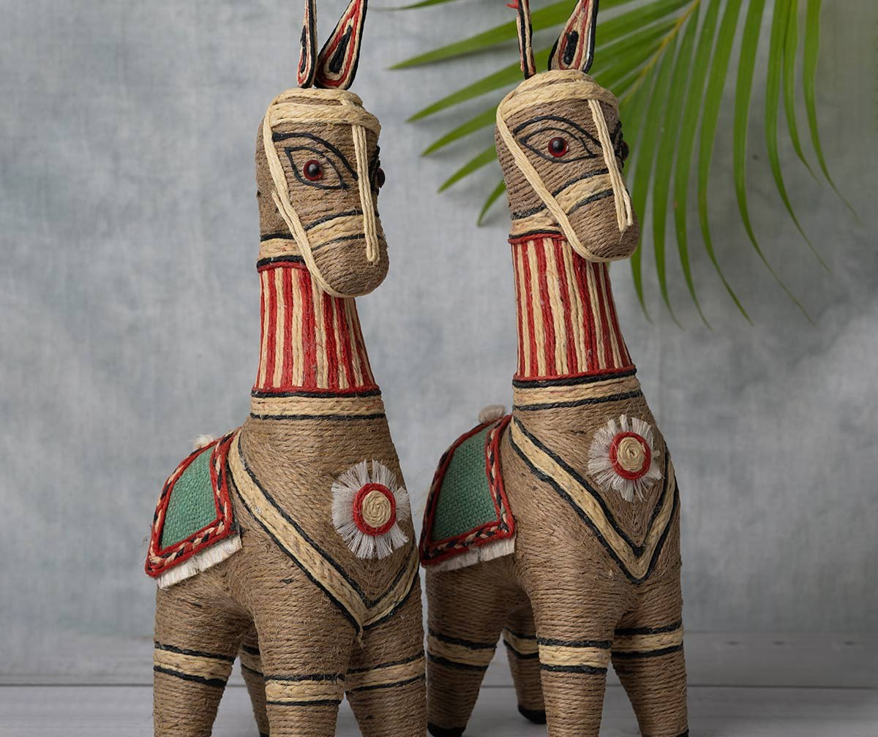
Quality Craftsmanship
At Home-Cave, we take pride in the exceptional craftsmanship displayed in every product. Our artisans pour their expertise and passion into each creation, ensuring that customers receive items of the highest quality and artistic value.

Slide 10
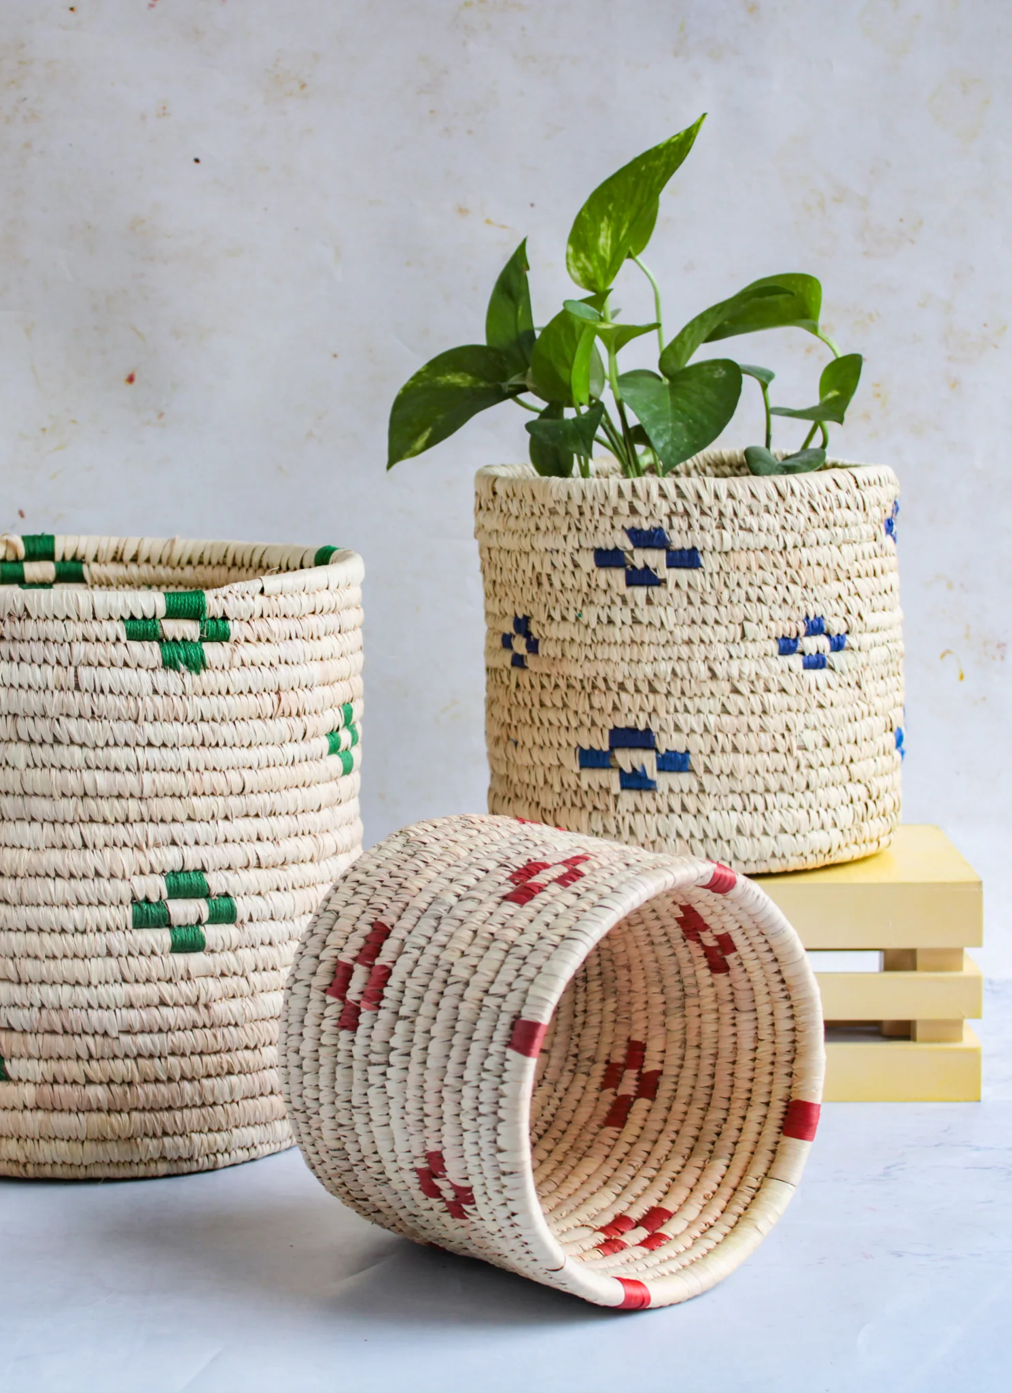
Customization Options
Embracing individuality, we offer customization options for select products, allowing customers to personalize their purchases. This be spoke approach enhances the connection between customers and the artisans, resulting in meaningful, one-of-a-kind creations.

Slide 11
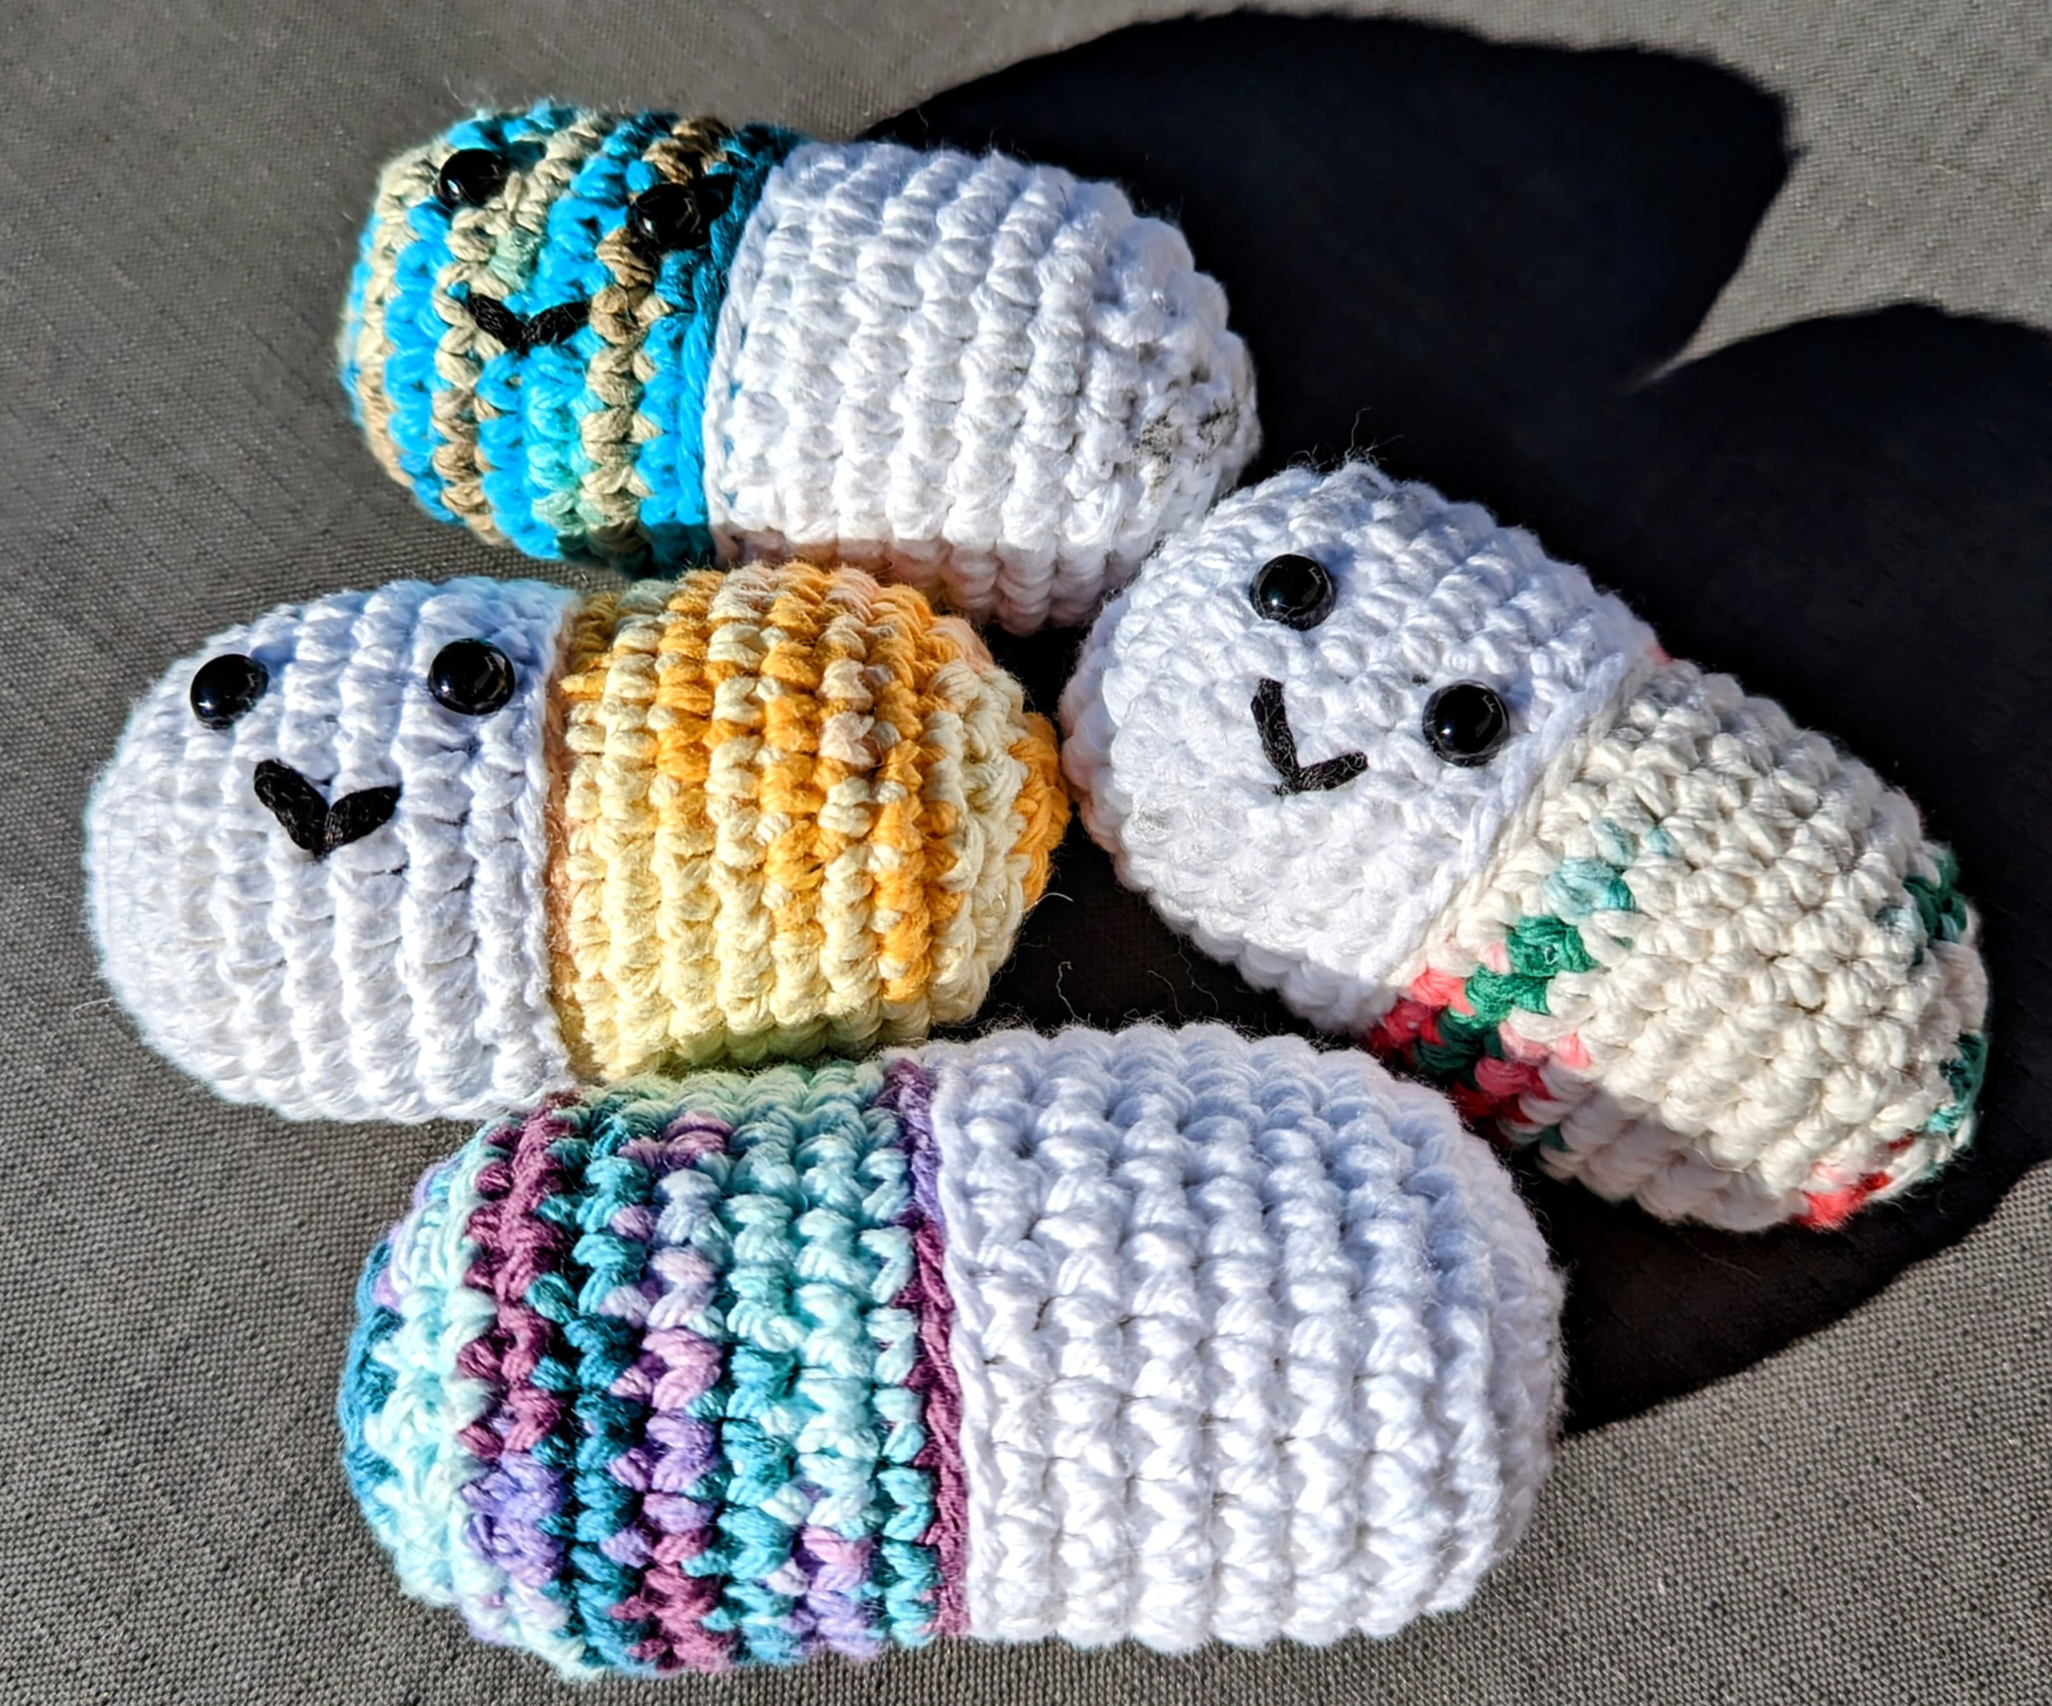
summary
So, we are going to create a website that offers authentic handmade products sold by independent entrepreneur, craftsmen, etc. Which will benefit both sellers and buyers.

Slide 12
Thank you

